Slide 1
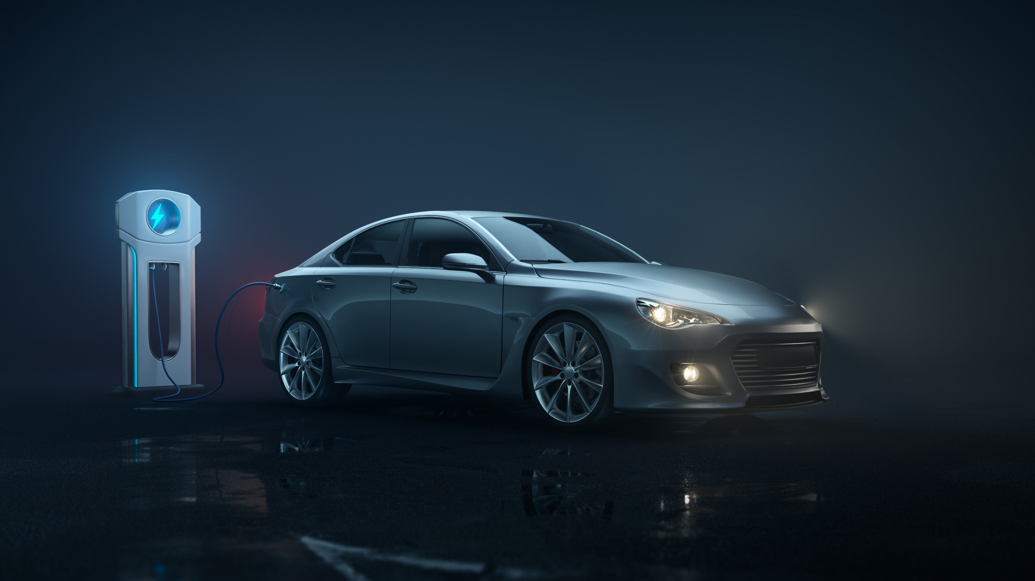
UBER ANALYSIS
Welcome to our project on Uber pickups in New York City.

Slide 2
INTRODUCTION:
Uber's main aim is to improve transportation all around the world. The problem they want to solve is that people often have to wait too long for an Uber ride. The goal is to help Uber drivers be in the right places at the right times so that users don't have to wait as much.

Slide 3
Project Overview:
We're working on a project to help Uber drivers in New York City find good places to pick up passengers. The main aim is to make it faster and easier for users to get an Uber ride.

Slide 4
Data Source:
We got information from the Uber Trip Data, specifically looking at New York City. This helps us understand where people need rides in a busy city.

Slide 5
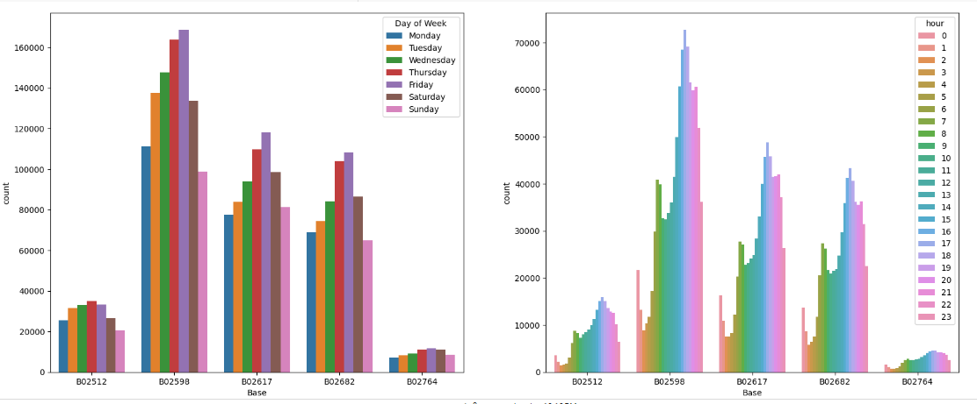
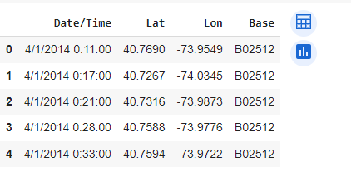
Data Exploration:
We checked out the information using tools like Pandas, NumPy, and Plotly. Looking at some example data, we found interesting patterns and trends in the places where people usually get picked up.

Slide 6
Data Preprocessing:
We made the data neater by cleaning it up and added more information, like the time and day. This helped improve the dataset by giving us extra details related to timing.

Slide 7
Clustering Techniques:
We used methods called KMeans and DBSCAN to organize pickup spots. These techniques helped us find places where Uber drivers are needed. The reason we used clustering is to group similar pickup locations together, making it simpler to understand where there's a lot of demand.

Slide 8
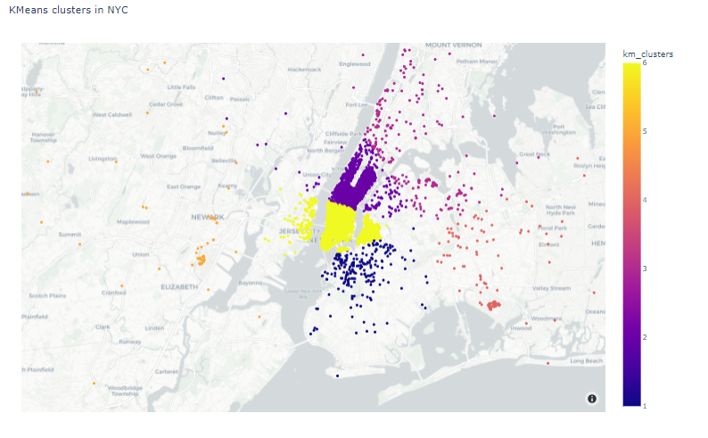
Kmeans Clustering:
KMeans helped us find potential hotspots for drivers.
Discovered areas where drivers might get more requests.

Slide 9
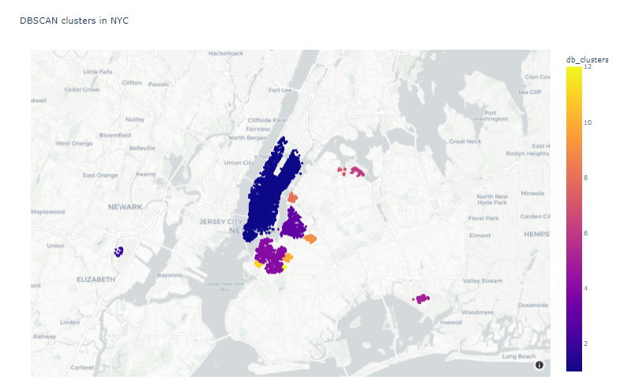
DBSCAN Clustering:
DBSCAN gave us more details about hot zones.
DBSCAN helped identify specific areas with high demand
DBSCAN gave us more details about hot zones. DBSCAN gave us more details about hot zone

Slide 10
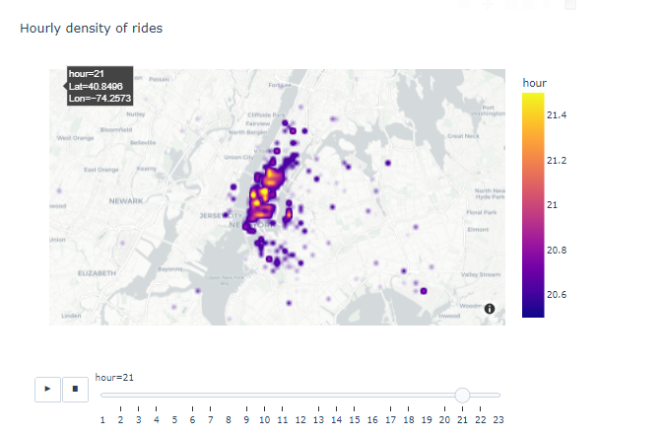

Insights:
We discovered interesting things from our analysis of clusters. We figured out the times and places where people need rides the most. This information can help guide Uber drivers to the busiest areas for better service.
DBSCAN gave us more details about hot zones. DBSCAN gave us more details about hot zone

Slide 11
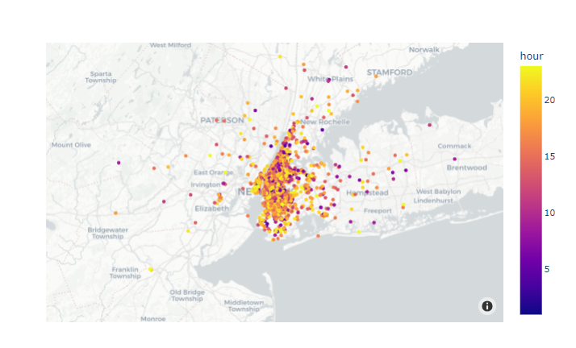
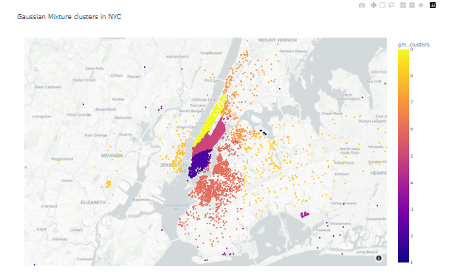
Recommendation:
We suggest drivers go to the busy areas we found to make waiting times shorter. This could help users get an Uber faster, improving the overall Uber experience.
DBSCAN gave us more details about hot zones. DBSCAN gave us more details about hot zone

